Slide 1
VE414 Project
Shengyuan Xu 518370910200
Fan Chen 518021910739
Qiansiqi Hu 519370910097

Slide 2
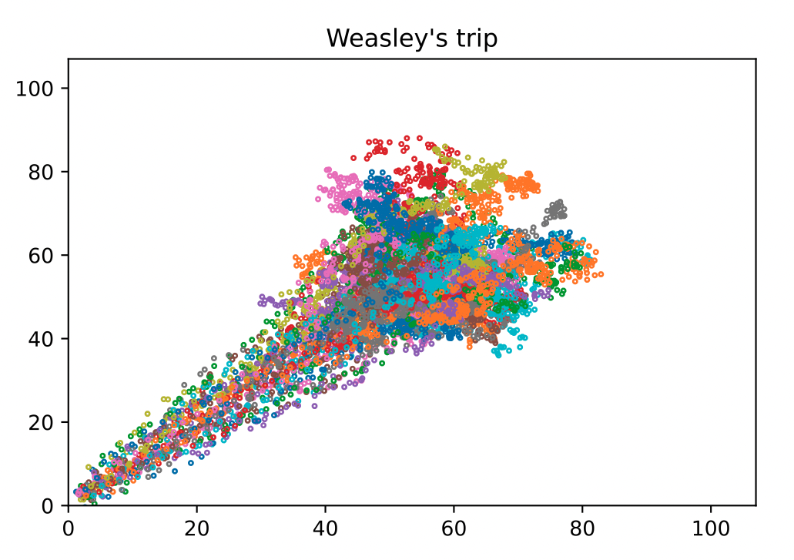
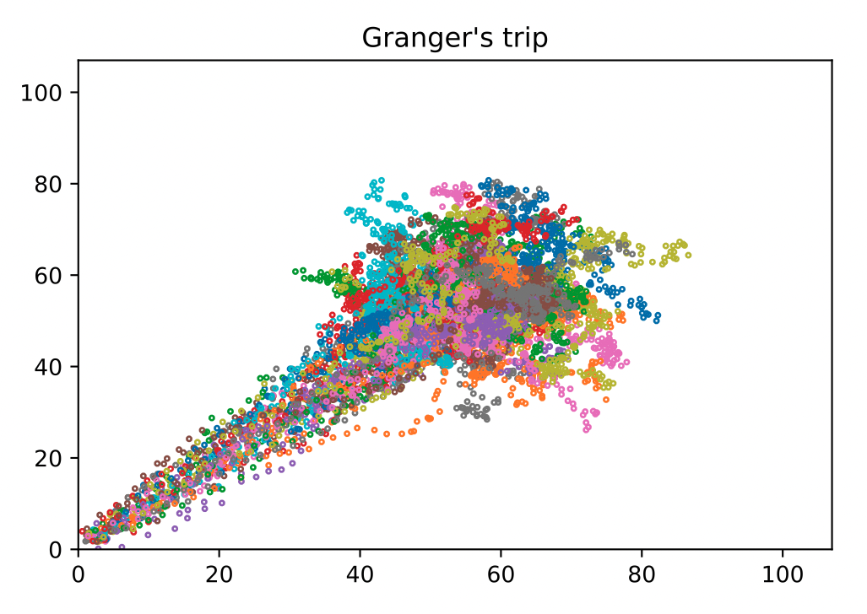
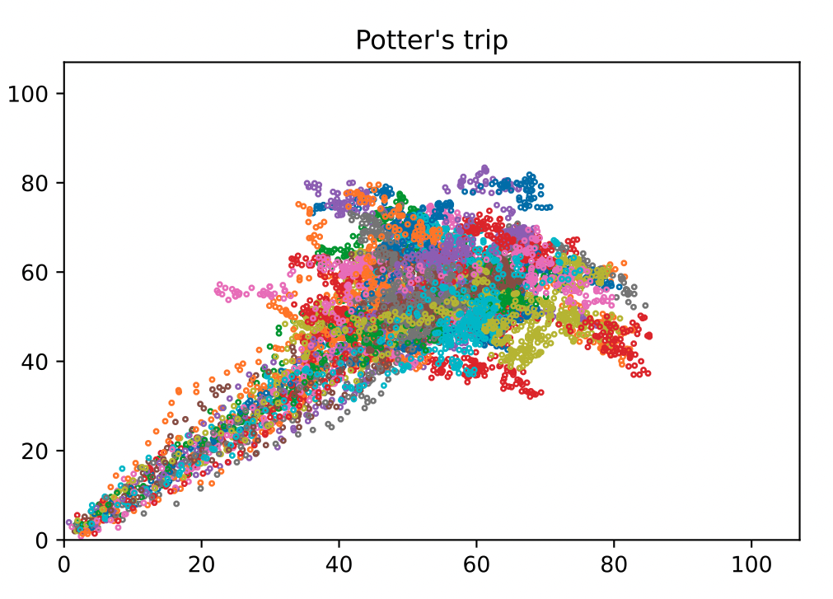
Magic Trip

Slide 3
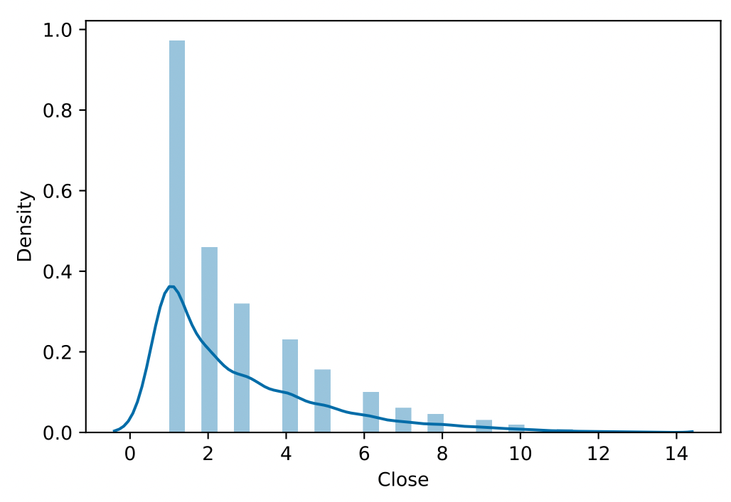
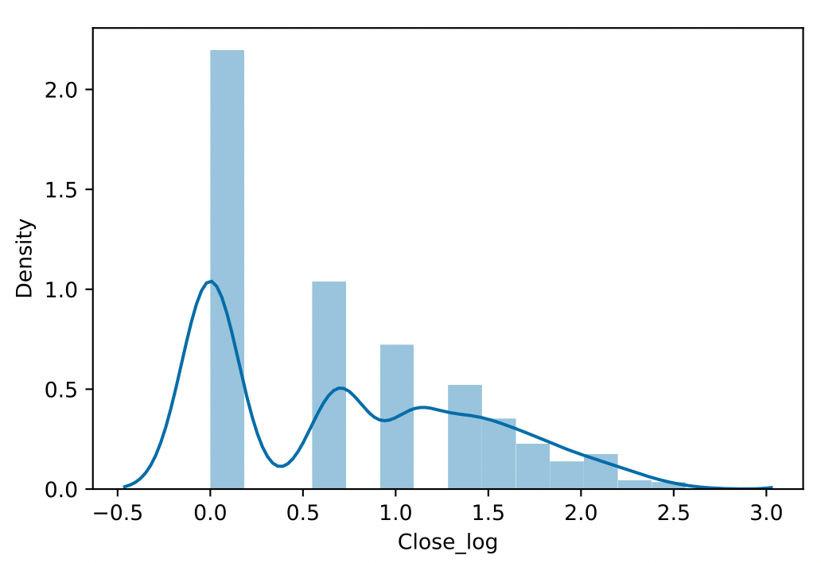
Distribution of Tayes
Data Transformation by log function

Slide 4
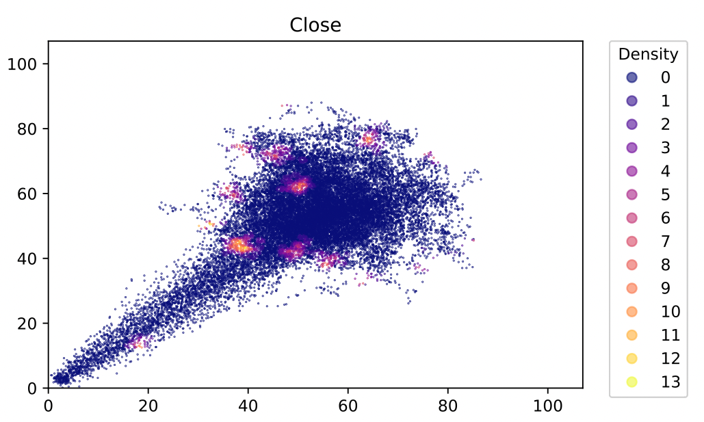
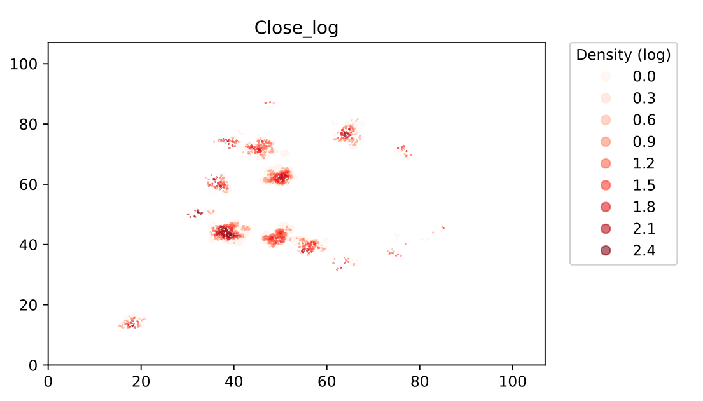
Distribution of Tayes
Data Transformation by log function

Slide 5
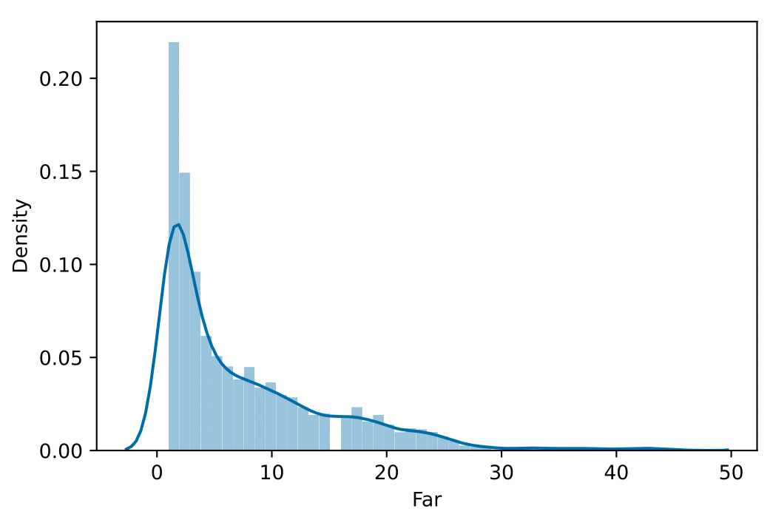
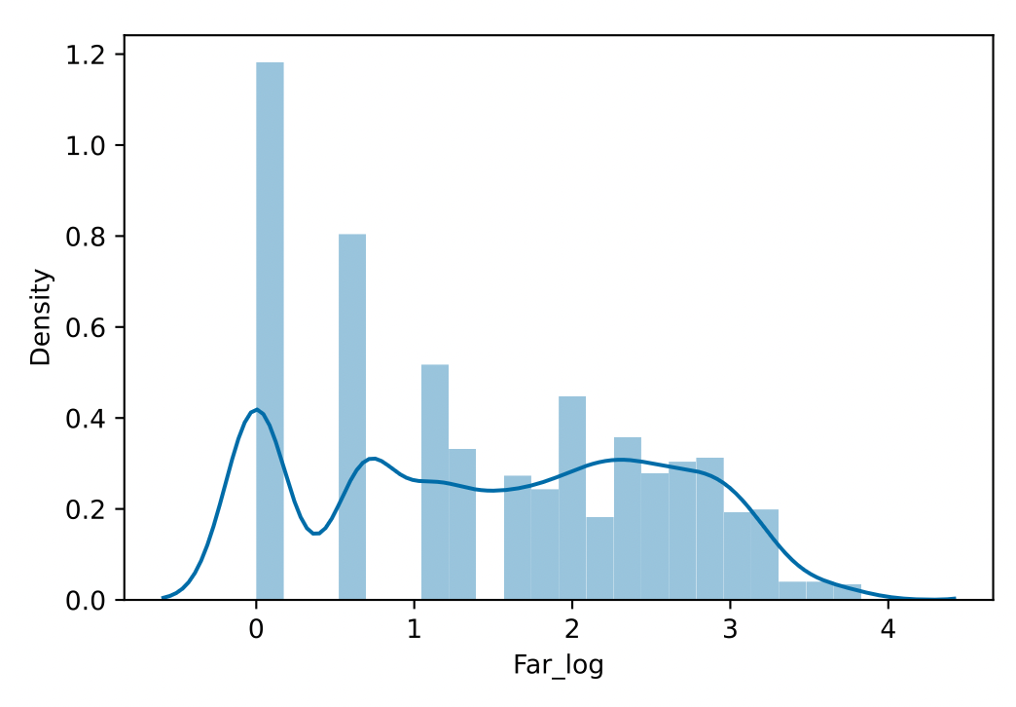
Distribution of Tayes
Data Transformation by log function

Slide 6
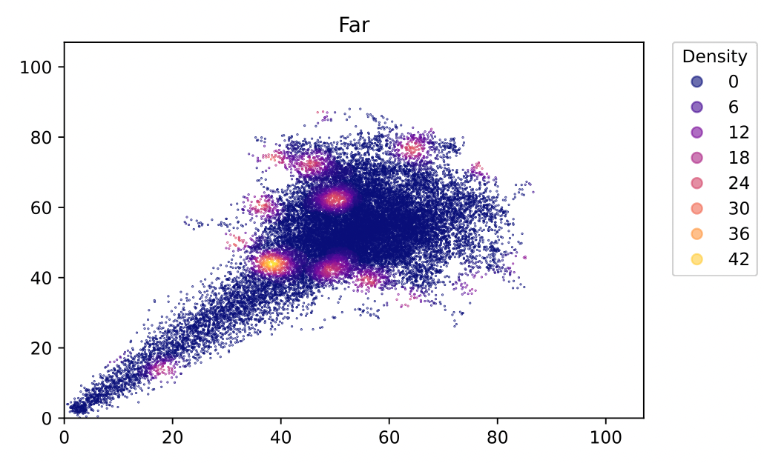
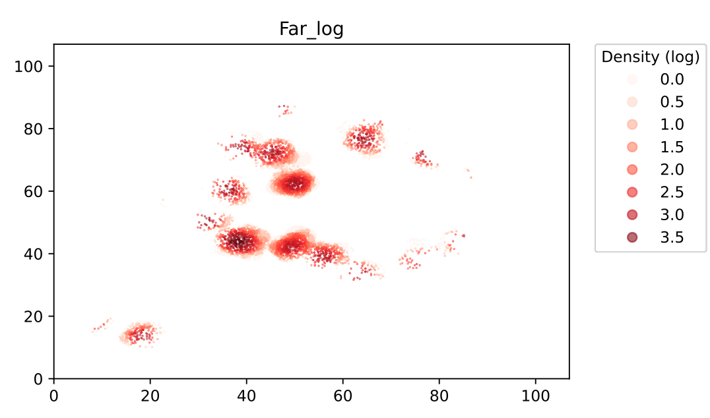
Distribution of Tayes
Data Transformation by log function

Slide 7
EM Clustering
Assumption: Gaussian mixture model
Goal:
estimate the number of clusters (Jiuling)
find out the approximate position of each Jiuling
look for possible improvements based on the result
Notes:
To find out the number of Jiuling, we first applied the EM method to perform clustering analysis. EM clustering is a model based on statistical distributions. We assumed that Tayes falling from a certain Jiuling follow a 2-D Gaussian distribution, and thus the dataset can be used to construct a Gaussian mixture model. Our goal is to esimate the number of clusters, find out the approximate position of each Jiuling, and look for possible improvements based on the result.

Slide 8
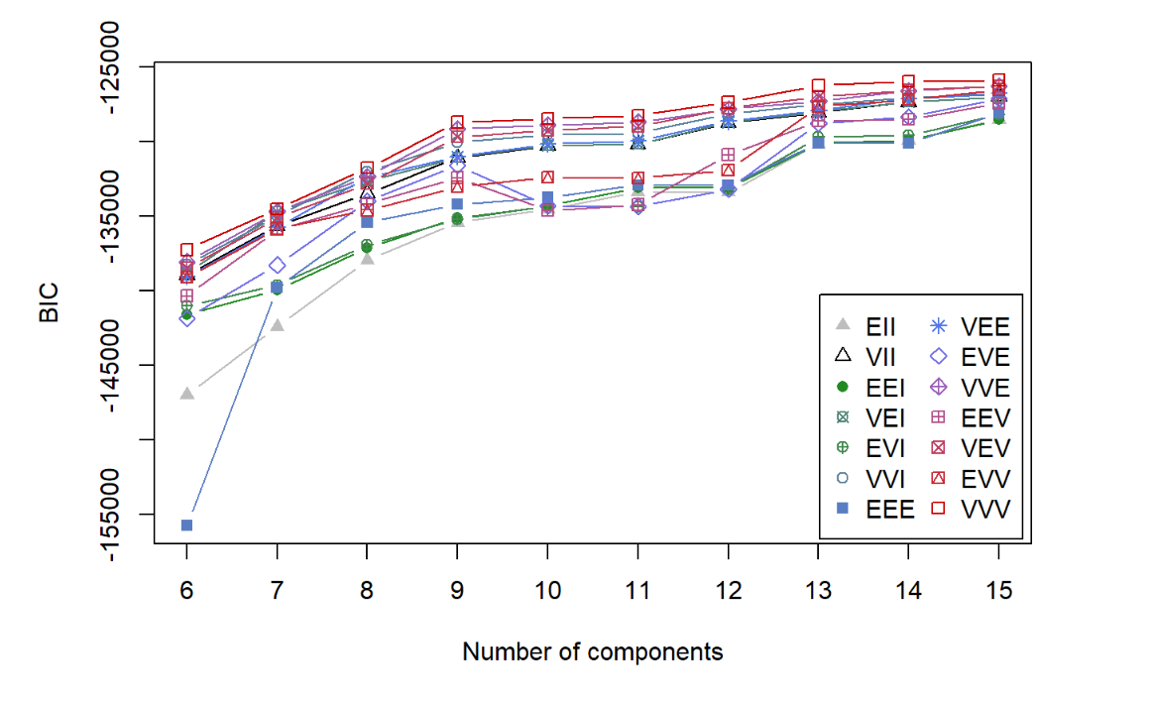
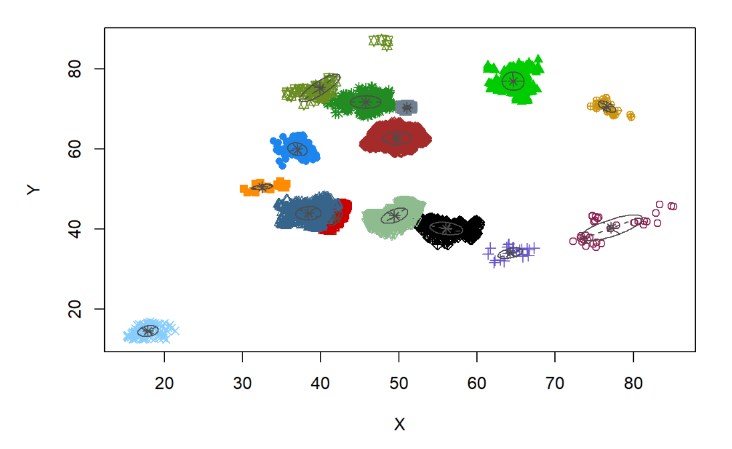
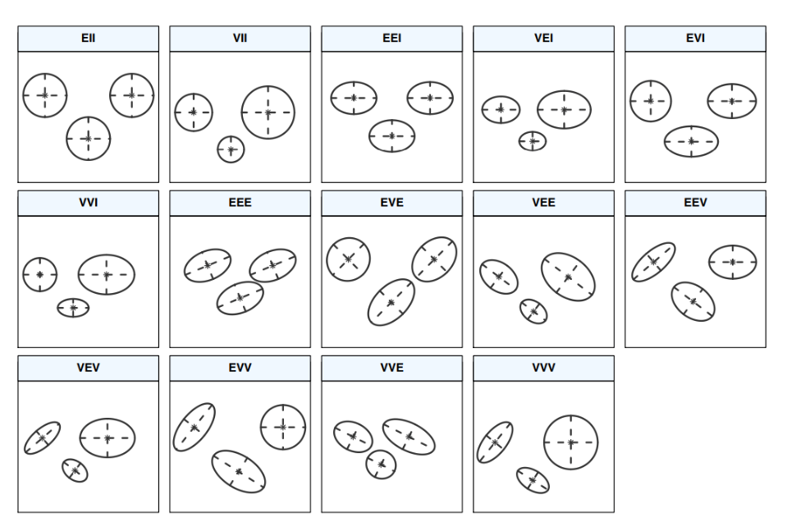
Analysis
BIC——Bayesian Information Criterion
Notes:
We applied the mclust package in R to perform EM clustering. The function inside selects the optimal model which maximizes the sum of BIC. As we can see from the left figure, BIC values gradually converge when number of components is larger than 13. And the right figure shows us the results: there're about 13 to 15 Jiuling.
(In the formula, k stands for the number of parameters of the model, n stands for the sample size, and L stands for the likelihood)
("EII".... are model names for multivariate data (spherical and diagonal models))

Slide 9
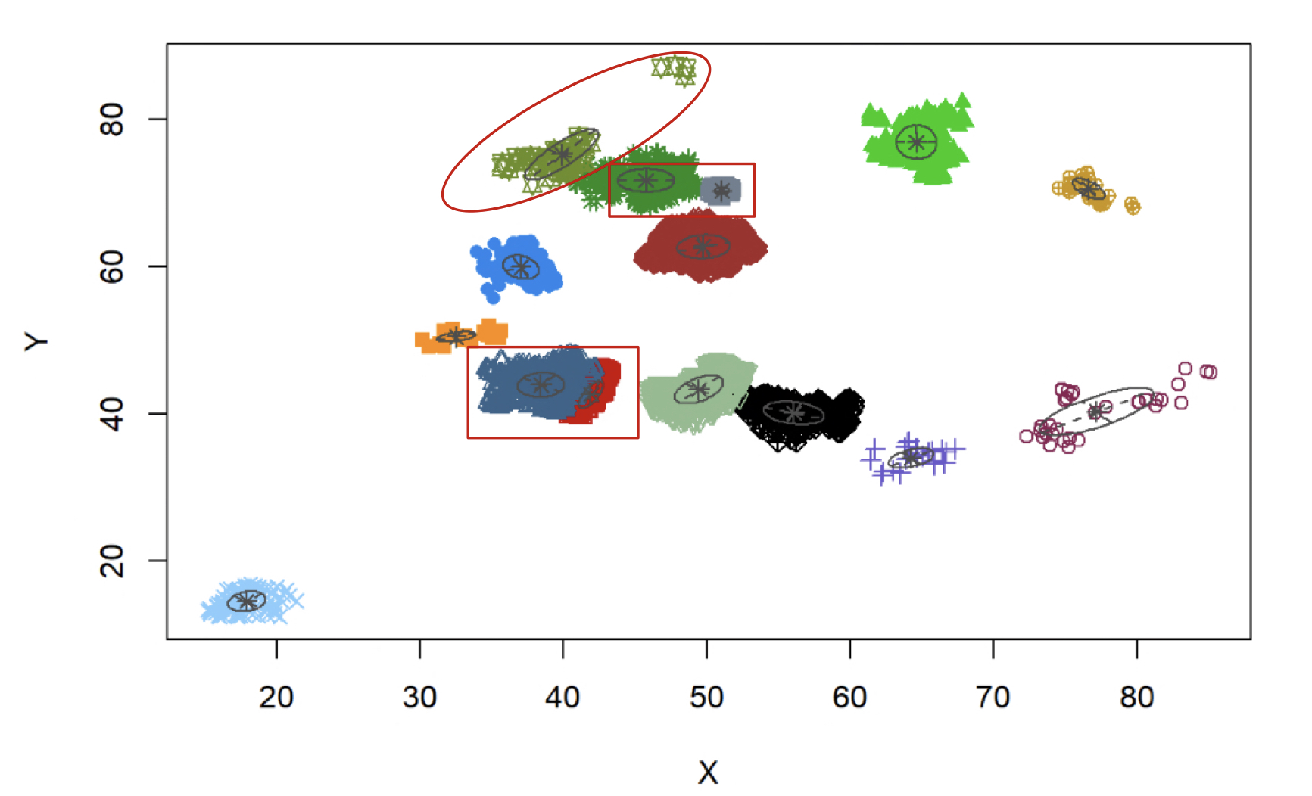
Analysis
Limitation
Concentrated distribution of data points
Based on nearby Tayes counts, rather than the actual number and location of Tayes
Possible solution
Aggregation of the data
Estimation of actual number and location of Tayes
Notes:
However, there do exist some problems in the clustering result. As we can see, in the circled part, though there's a huge gap between the two point clusters, they were classified as Tayes from the same Jiuling. While for the two boxed parts, there doesn't exist a gap, but the points were classified into two clusters. This may result from the density distribution of the data points. For the upper point cluster, only few data were collected, and as a result, they shared a low weight when performing clustering. Moreover, the data points with term "Close" larger than 0 cannot represent the exact distribution of Tayes. Though it won't pose a great impact on the clustering result, it can lead to great deviations in the source of each cluster, that is, the position of each Jiuling. Therefore, improvements are needed in order to provide a more accurate result.

Slide 10
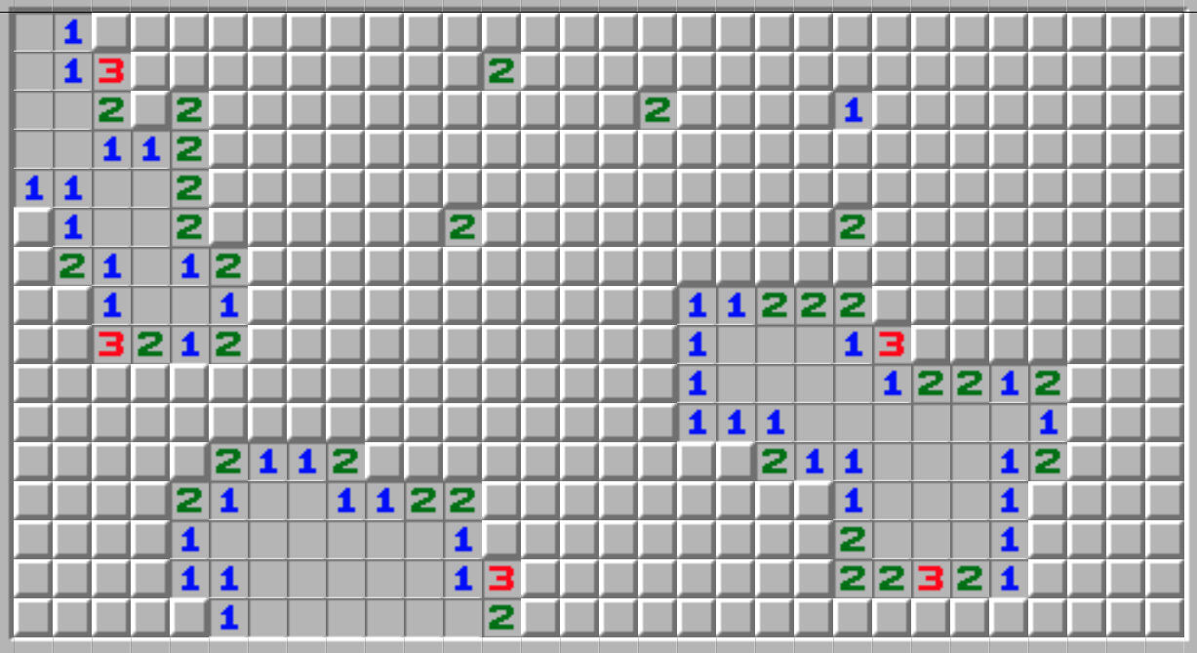
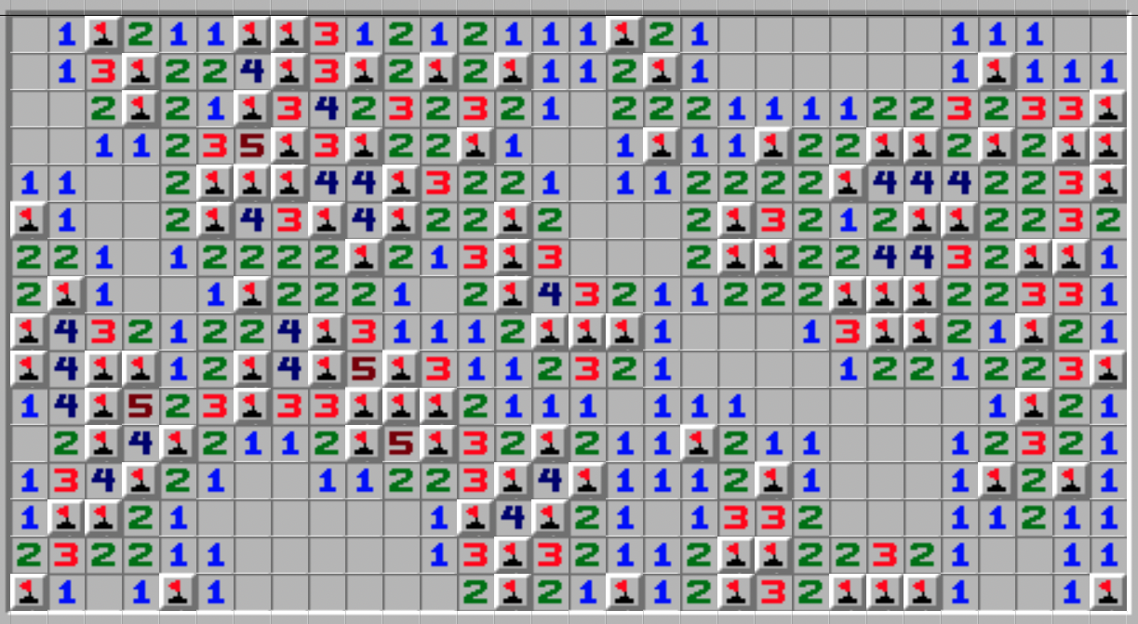
Tayes Distribution Estimation
Key Problem: Estimate the number and location of Tayes
Maybe we can act as minesweepers

Slide 11
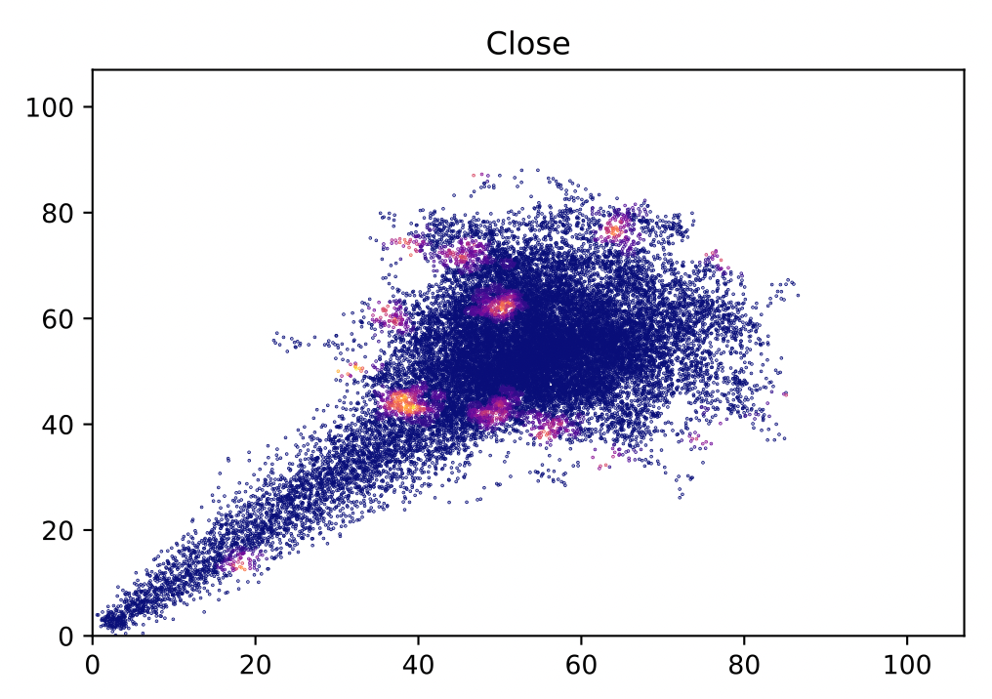
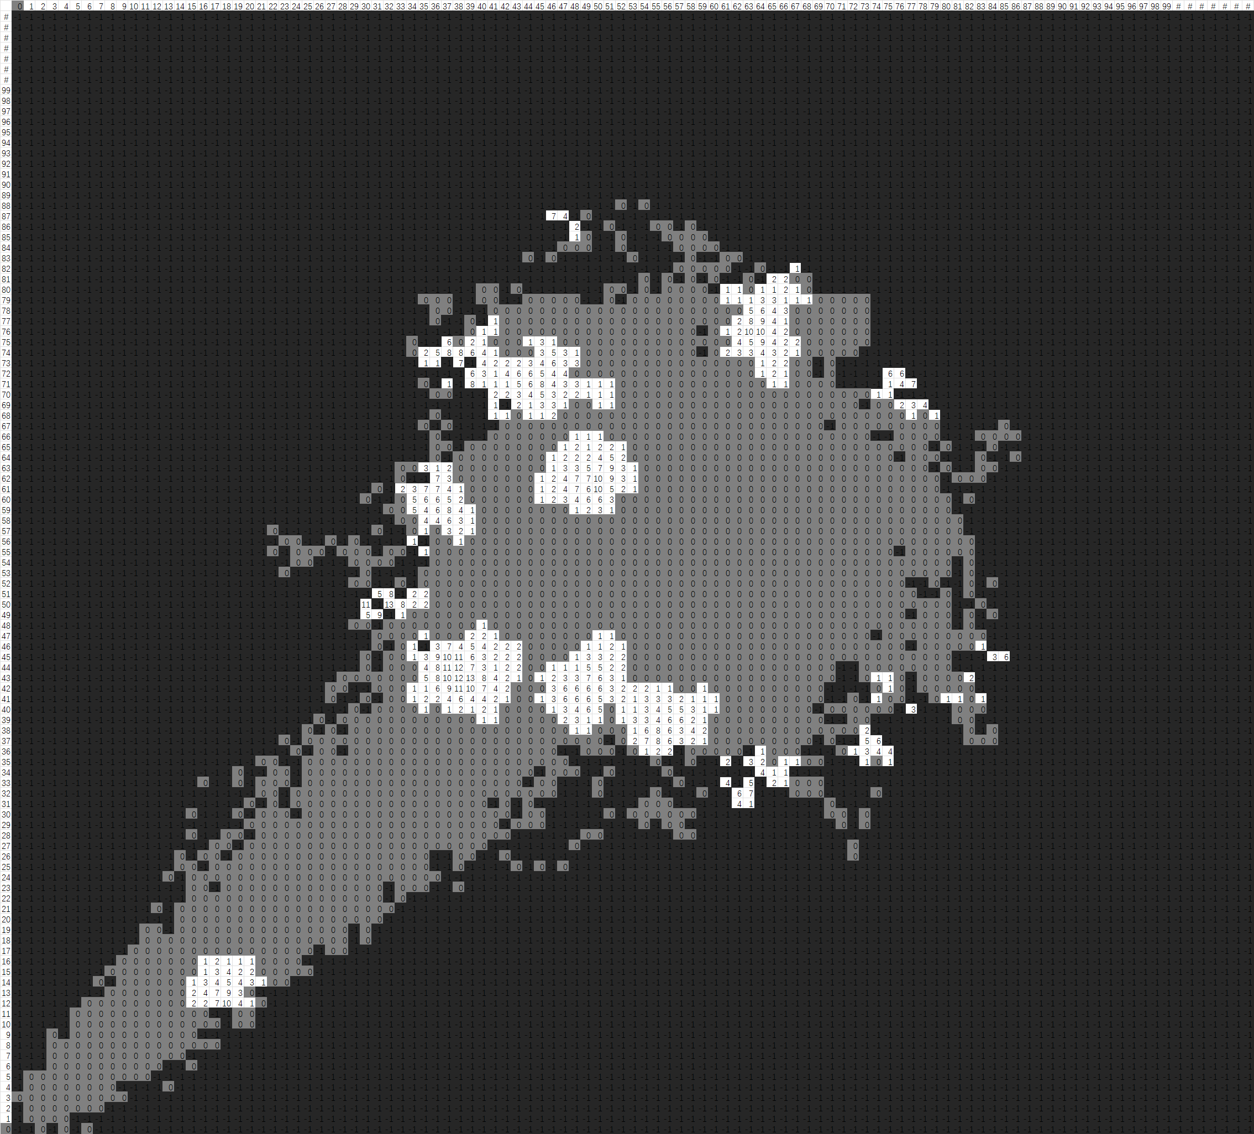
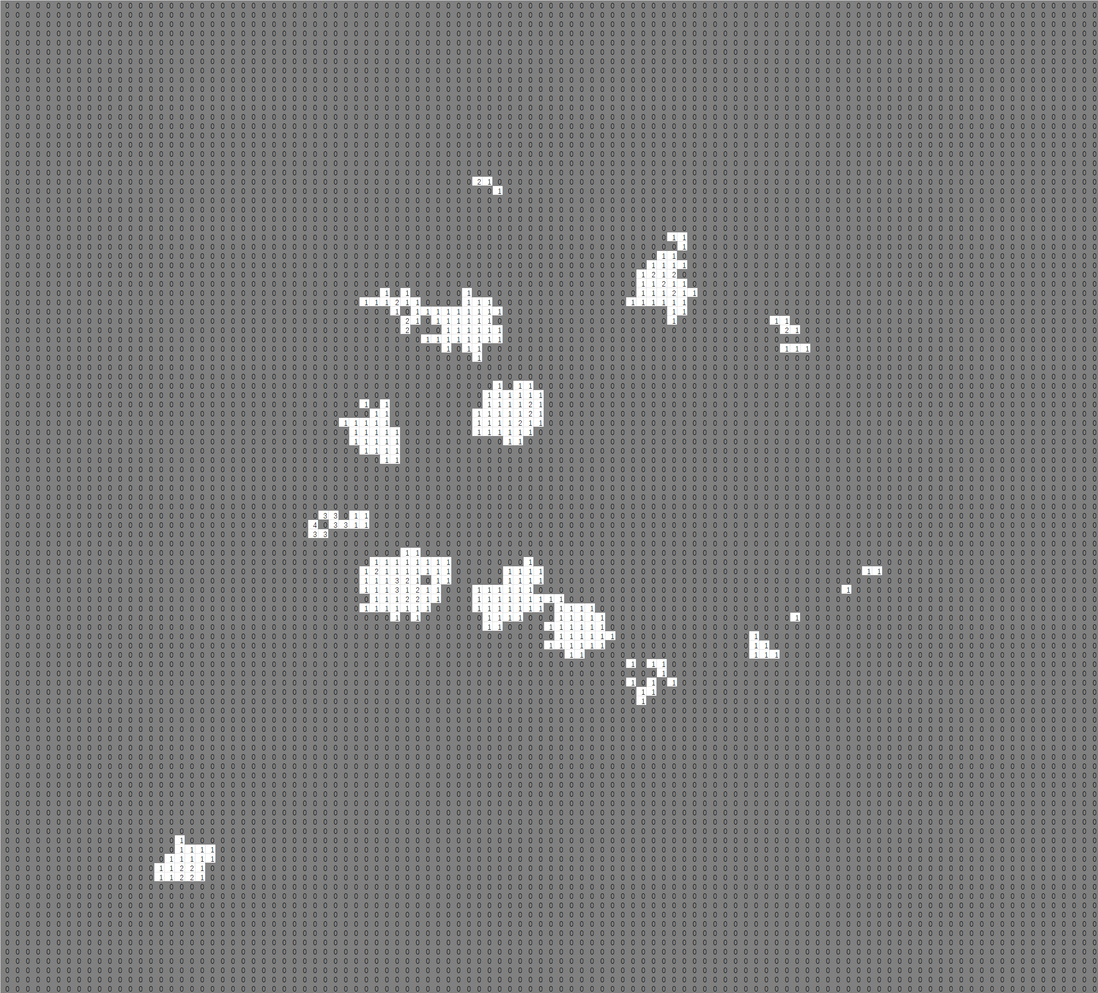
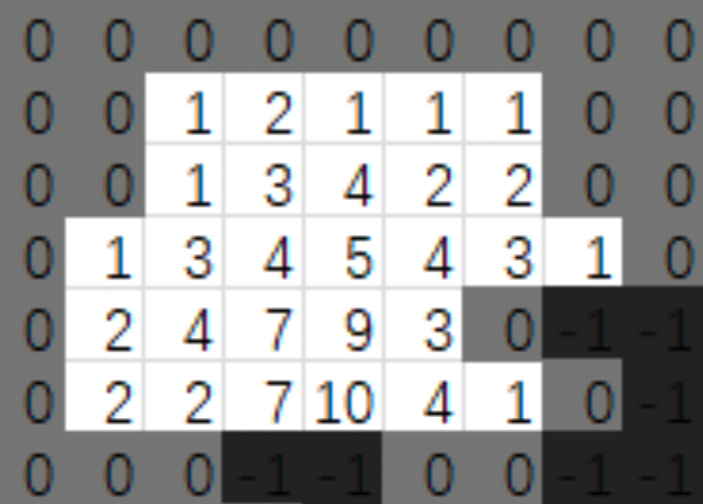
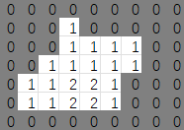
Tayes Distribution Estimation
grid
Mine Algorithm
aggregate

Slide 12
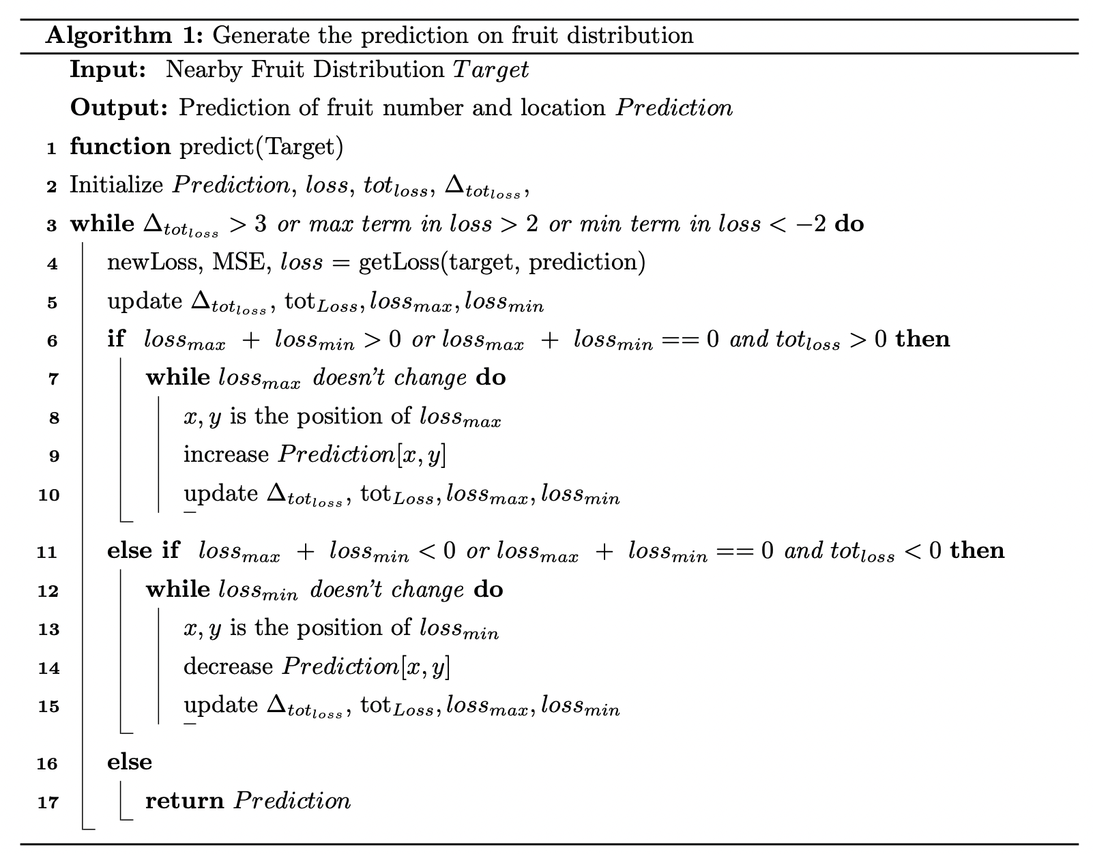
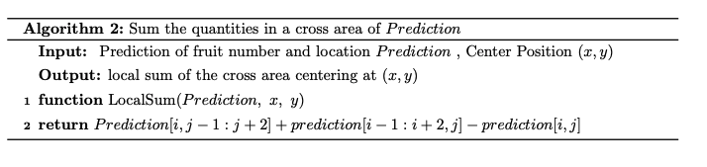
Mine Algorithm

Slide 13
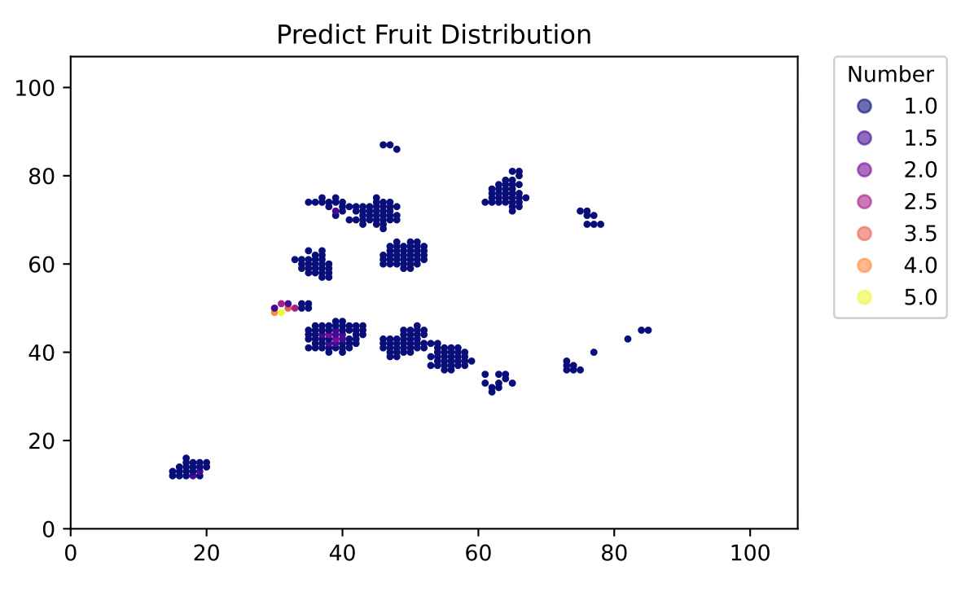
Tayes Distribution Estimation

Slide 14
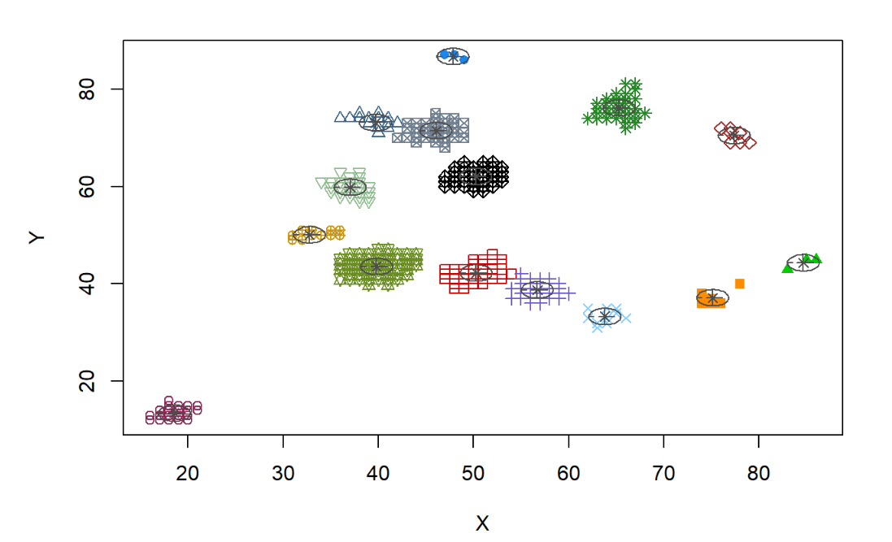
Result Comparison
Previous Updated

Slide 15
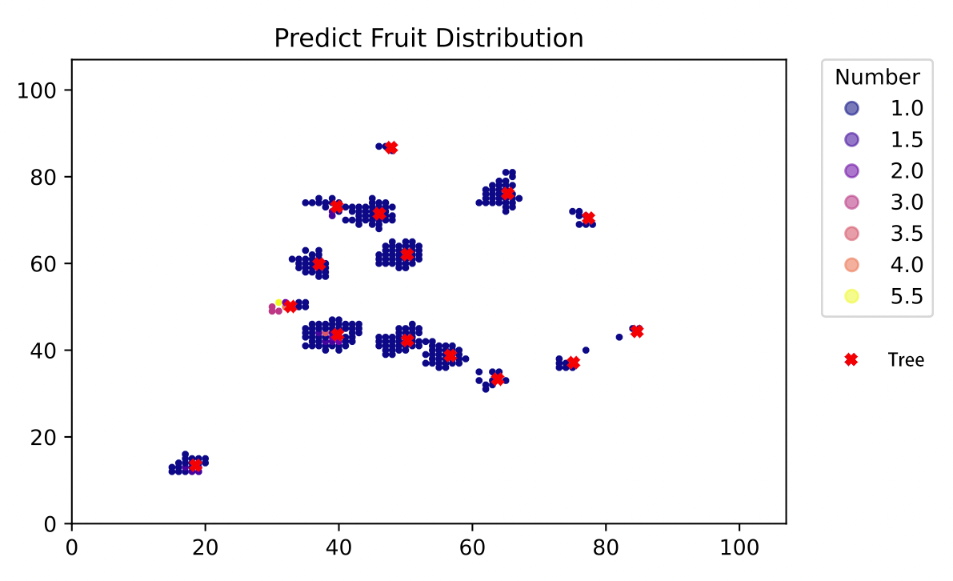
Tayes Distribution Estimation
# of Taye: 351
# of Jiuling: 15

Slide 16
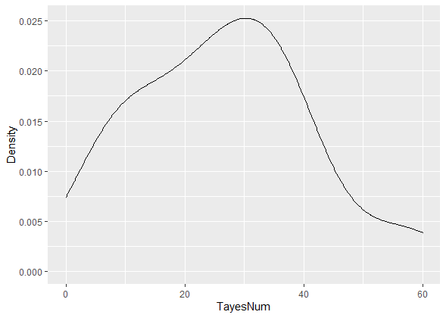
Tayes Number pre Jiuling
Roughly a Gaussian Distribution with μ = 30
Left part slightly higher than Gaussian Distribution
little information on clusters at the edge of explored area

Slide 17
What about the total number of Jiuling?
Assumption
Jiuling are uniformly randomly distributed
Quantity predicted >> Total quantity
Area detected >> Total area
Estimation of area detected
Modified Graham-scan Algorithm
Sum of detected grid

Slide 18
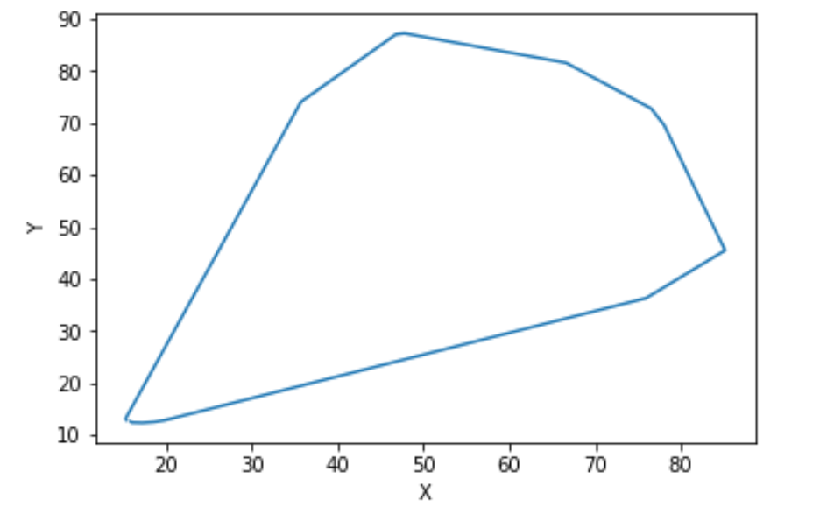
Regular Graham-scan Algorithm
Regular Graham-scan algorithm
Size : 2927.89

Slide 19
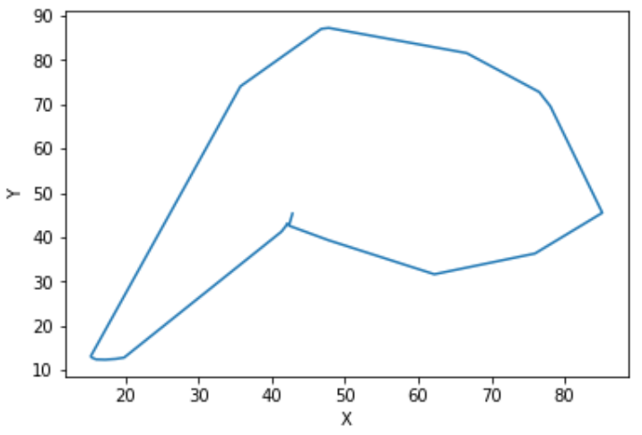
Modified Graham-scan Algorithm
Regular Graham-scan algorithm
Size : 2927.89
Proportion : 25.57%
Modified Graham-scan algorithm
Size : 2480.89
Proportion : 21.66%

Slide 20
Area Estimation
General idea:
Divide the forest into 107 *107 tiny grids
For each grid, if there exists any record of trip within one meter, mark this grid as detected.
Calculated the total size of grids detected.

Slide 21
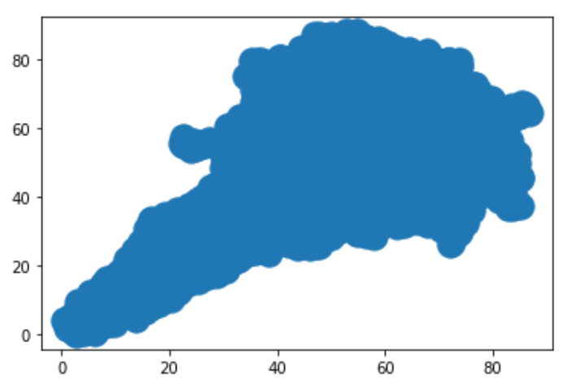
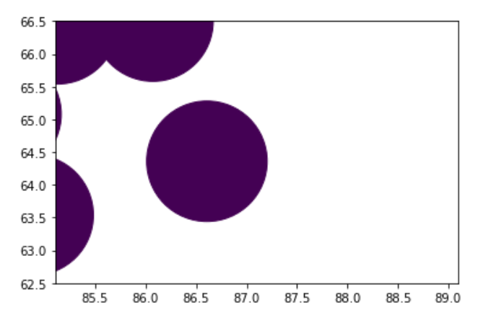
Area Estimation
Total Size : 3228
Proportion : 28.19%

Slide 22
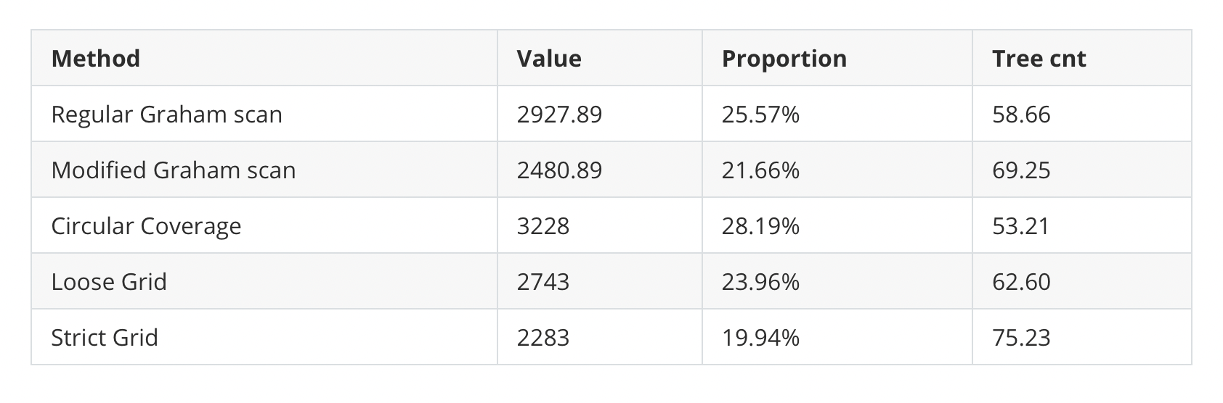
Area Estimation

Slide 23
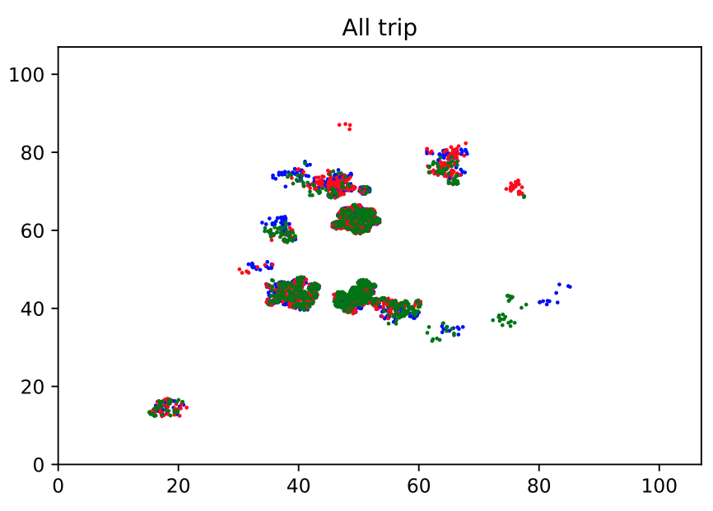
What if Jiuling can move?
Two key questions:
Existence of Tayes
(permanent or not)?
How Tayes fall from Jiuling
(continuous or periodic)?
(frequent or rare)?
Notes:
Then what if Jiuling can move? We must rethink about the utility of the existing data. For points with term "Close" > 0, as we can see from the plot, many trip records of Potter, Weasley and Granger overlapped, and gaps often exist between different clusters. Then two key questions about Tayes are raised: Do tayes exist permanently? On what basis do Tayes fall from Jiuling? For example, if tayes exist permanently, fall from Jiuling continuously and frequently, then we can determine the moving range of each Jiuling. If tayes exist permanently and fall from Jiuling periodically, then it may also be reasonable to assume that there's only one Jiuling! Different assumptions can lead to very different results.

Slide 24
And we'll Need:
Starting time of each trip
More groups of data covering the whole forest
More people travelling at the same time
Notes:
On the other hand, in terms of dataset, if Jiuling can move, the existing data is far not enough. One most important thing is to record the starting time of each trip, since the position of each Jiuling may vary over time. Moreover, we need more people travelling at the same time. Simultaneous record of data & observations at different positions can be extremely helpful. Besides, more groups of data covering the whole forest are needed. Because one Jiuling can move towards anywhere inside the forest, estimating from local to whole lacks accuracy and becomes less convincing.

Slide 25
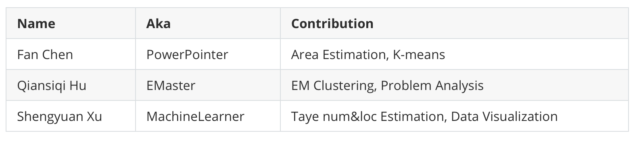
Work Distribution

Slide 26
Thanks!

